Slide 1
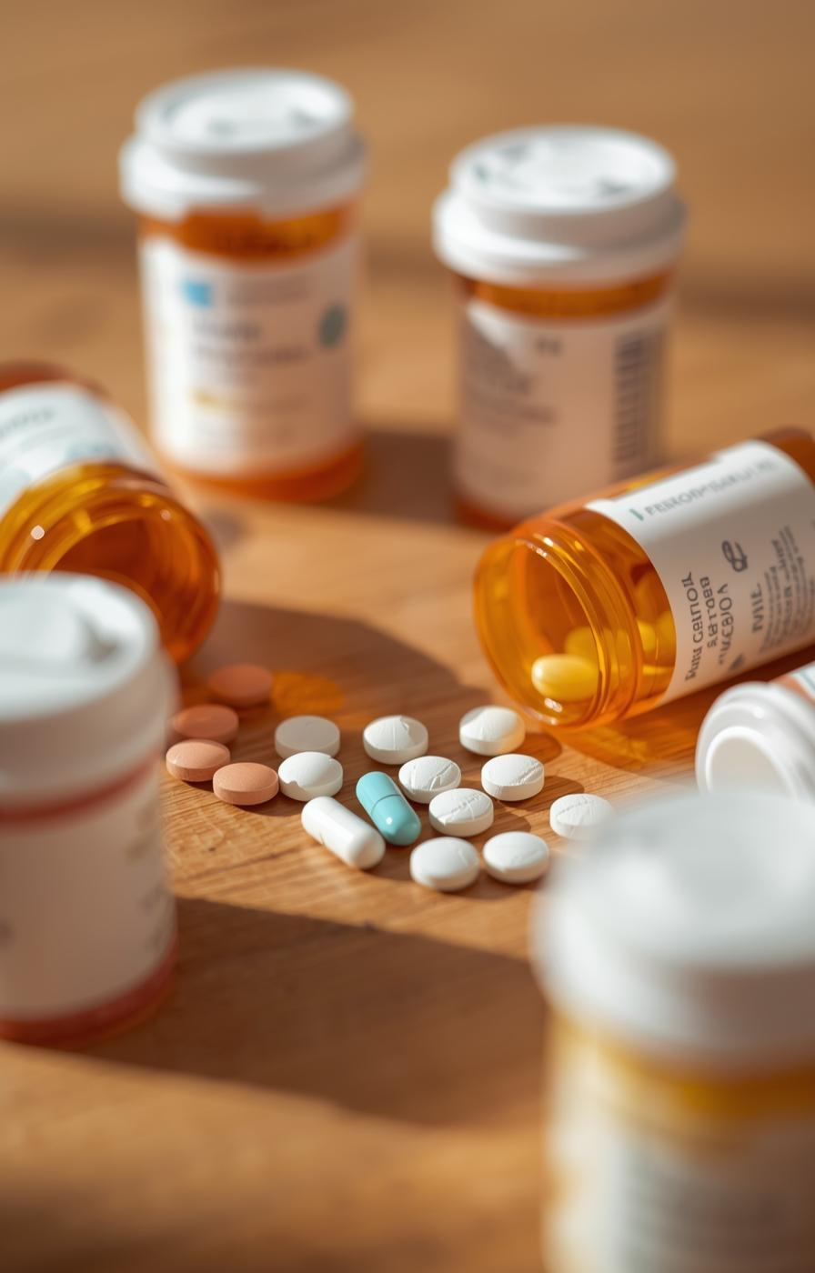

SPARD
Smart Prescription Analyzer Risk Detector
Aditya Raj - 1MS23IS005
Anish D Tabib - 1MS23IS015
Anshya Kachroo - 1MS23IS017
Aadya Banninthaya - 1MS23IS001

Slide 2
Introduction
  Patients often visit multiple doctors for different health issues.
  They frequently forget or do not carry previous prescriptions.
  This leads to accidental mixing of medicines from different doctors.
  Such combinations can cause serious drug–drug interactions or allergy reactions.
  There is no simple system to warn patients about these risks before consuming the medicines.
2

Slide 3
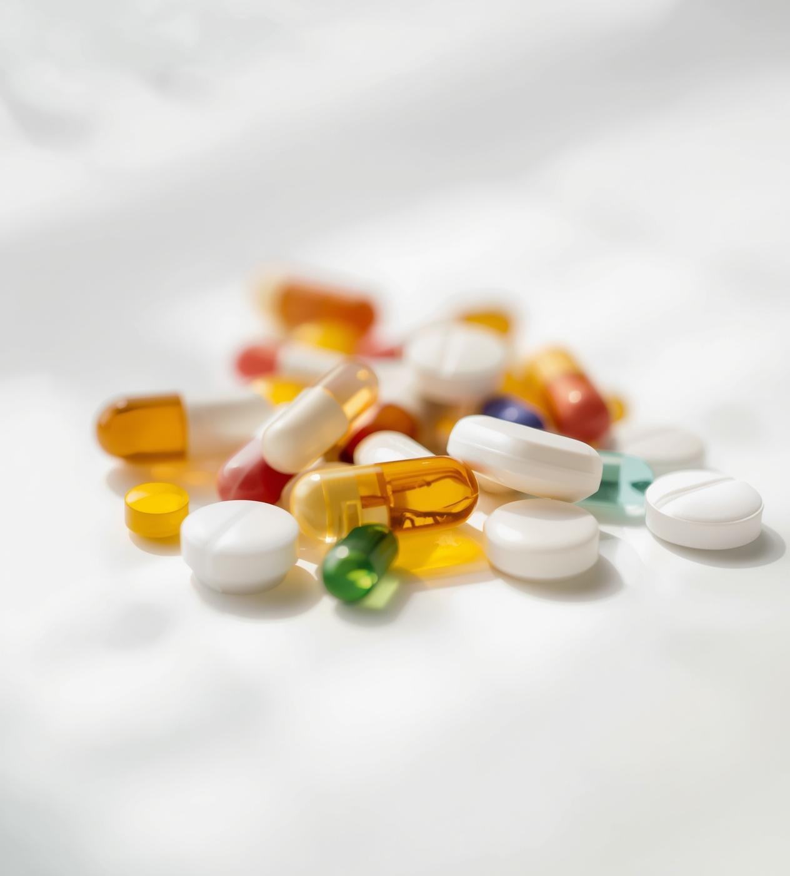
How it works
  Users upload photos of their prescriptions to the system.
  SPARD reads and extracts medicine names using OCR.
  The system checks for allergy-related warnings based on user history or known allergies.
  SPARD compares medicines across both prescriptions.
  It detects:
1. duplicate medicines
2. harmful drug combinations
3. allergy risks
  The system then generates a clear, easy-to-understand safety report for the user.

Slide 4
Tech stacks used
Frontend
  HTML
  CSS
  JavaScript
Backend
  Flask (Python REST API Framework)
Framework
  Tesseract.js
Core Processing
  Tesseract OCR (Extracting text from prescription images)
Database
  SQLite

Slide 5
User Uploads prescription photo
OCR Reads medicines from image
Flow Diagram
System Identifies medicines from database
Checks for risks
  Energy Conflicts
  Drug-drug interaction
Generates safety report

Slide 6
Conclusion
  Medication safety should not depend on memory, luck, or assumptions.
  SPARD transforms prescriptions into meaningful, actionable safety insights.
  It empowers patients, supports doctors, and prevents avoidable harm.
  With SPARD, every prescription becomes safer, smarter, and more transparent.

